Slide 1
eXo JCR
JCR concepts, architecture and benefits
Notes:
1
1

Slide 2
Who is the trainer?
2
Notes:
2
2

Slide 3
Who is the trainer?
Project Leader JCR (Sep 2009)
Management of the product roadmap
Technical and functional leader of the product
Management of the product backlog (PO)
Responsible for product quality
Audit of the code produced by the development team
Implementation of advanced features of the product
Responsible for product architecture
R&D

Slide 4
Table of Contents
4
Notes:
4
4

Slide 5
Table of Contents
JCR Introduction
JSR 170 Overview
Overall architecture
JCR Connectors
Important Links
Exercise
eXo JCR version history

Slide 6
JCR Introduction
6
Notes:
6
6

Slide 7
JCR Introduction
JSR 170 (June 2005)
Motivation
The number of vendors offering proprietary content repositories has increased
Avoid the costs associated with learning the particular API of each repository vendor
Being able to exchange the underlying repositories
Notes:
As the number of vendors offering proprietary content repositories has increased, the need for a common programmatic interface to these repositories has become apparent. The aim of the Content Repository for Java Technology API specification is to provide such an interface and, in doing so, lay the foundations for a true industry-wide content infrastructure.
Application developers and custom solution integrators will be able to avoid the costs associated with learning the particular API of each repository vendor. Instead, programmers will be able to develop content-based application logic independently of the underlying repository architecture or physical storage.
Customers will also benefit by being able to exchange their underlying repositories without touching any of the applications built on top of them.

Slide 8
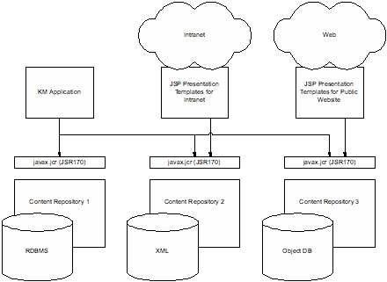
JCR Introduction
Use Case #1: Swappability
Notes:
ENT Corporation, a large distributed enterprise, has different content management systems in different divisions. Their Knowledge Management (KM) team has developed an idea for better discovery of corporate assets across the various repositories.
The team implements the application using the Content Repository for Java Technology API to the content management (CM) systems. As the KM team finds more CM systems across the enterprise, the application can easily harvest the new data as well as that from the existing systems.
Additionally, the presentation templates that cover the corporate design guidelines for the organization have been developed based on this specification in a Java framework around JSP.
A year later, two divisions switch their CM vendors. As part of the migration process, the KM discovery application is tested against the new CMS in those divisions. Other than having its configuration file updated, the application works as before.
Through their standardized interface these repositories allow simple migration of the content from the two old repositories to the new one; this means that the content can be converted from the source repository to the newly purchased destination repository through a simple export and import.
Furthermore, all the content presentation templates developed against this specification keep working as before. In the case of ENT the development of this presentation logic was one of the major investments made when the intranet and the public Internet website were first developed. Being able to migrate this logic painlessly to work on top of the new repository is therefore of great benefit.

Slide 9
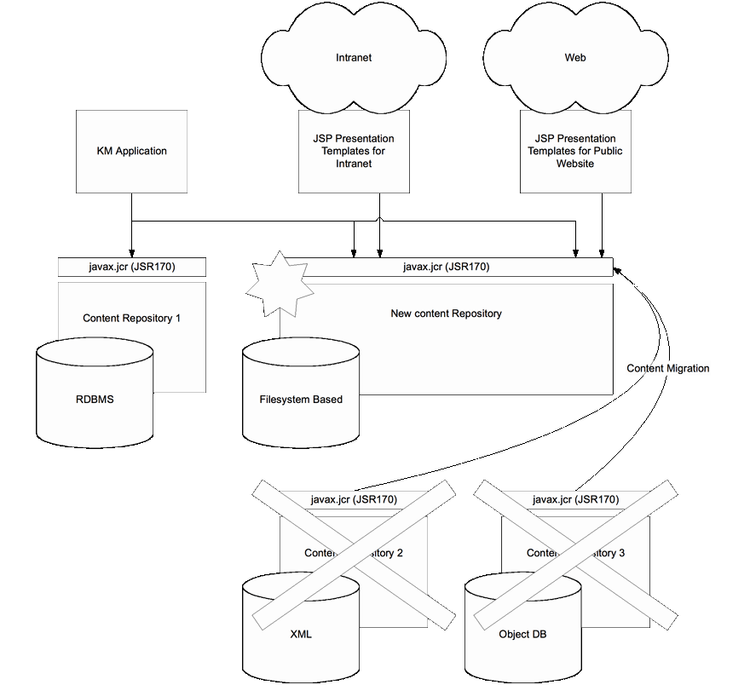
JCR Introduction

Slide 10
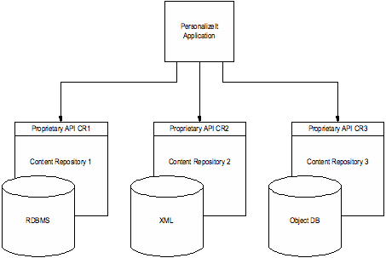
JCR Introduction
Use Case #2: Resource Crunch (Personalization)
Notes:
PersonalizeIt Software Corp., a vendor of personalization and portal software, needs to gain access to meta-information and content that is aggregated and managed by content management systems.
Since, historically, the CM market has been quite diverse, PersonalizeIt has had to integrate into many different proprietary APIs. This meant that PersonalizeIt had to spend a large amount of time familiarizing their developers with these APIs and had to maintain compatibility with all the different APIs as the various CM vendors' products evolved.
Since the adoption of this specification, PersonalizeIt offers a standard interface to compliant repositories. Therefore, they no longer have to maintain dozens of proprietary integrations and can concentrate on their core competency.

Slide 11
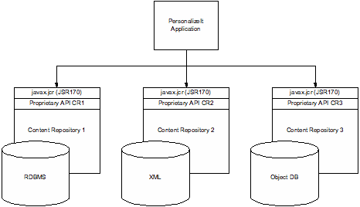
JCR Introduction

Slide 12
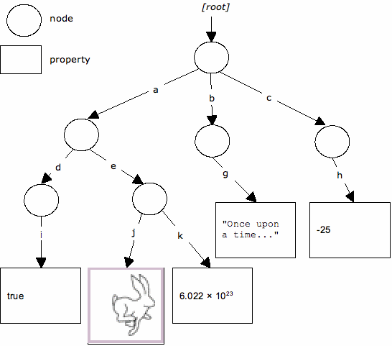
JCR Introduction
The Repository Model
Notes:
A content repository consists of one or more workspaces, each of which contains a tree of items. An item is either a node or a property. Each node may have zero or more child nodes and zero or more child properties. There is a single root node per workspace, which has no parent. All other nodes have one parent. Properties have one parent (a node) and cannot have children; they are the leaves of the tree. All of the actual content in the repository is stored within the values of the properties.
In the diagram above, we see the single root node of some workspace with child nodes a, b and c, each of which have further child nodes or properties. For example, the node a has two child nodes, d and e. Node e, in turn, has two properties, j and k. The property j contains an image (a picture of a rabbit) and k contains a floating-point number (6.022 × 1023). Similarly, the property i contains a boolean value (true), the property g contains a string (“Once upon a time...”) and the property h contains an integer (-25).
Any item in the hierarchy can be identified by an absolute path. For example, the path / refers to the root node and the path /a/d/i refers to the property with value true. Absolute paths always begin with a / character.
A relative path specifies a node or property relative to another location within the hierarchy. For example, relative to node /a in the above diagram, the path to the property with value true is d/i. The Unix-style path segments “.” and “..” (meaning respectively, “this” and “parent”) are also supported so that, relative to /a, the property containing the value –25 would be ../c/h. Relative paths are distinguished from absolute paths by having no leading / character.

Slide 13
JSR 170 Overview
13
Notes:
13
13

Slide 14

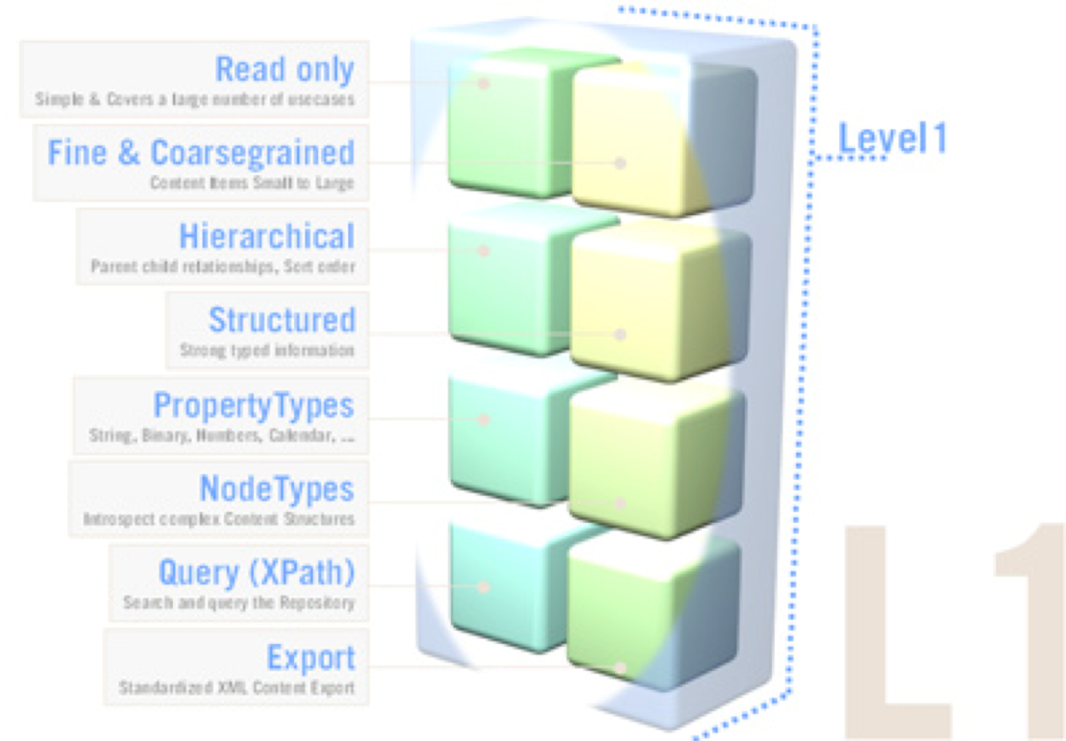
JSR 170 Overview
Level 1 includes :
Retrieval and traversal of nodes and properties
Reading the values of properties
Transient namespace remapping
Export to XML/SAX
Query facility with XPath syntax
Discovery of available node types
Notes:
Compliance levels
the repository is “level 1 “compliant

Slide 15

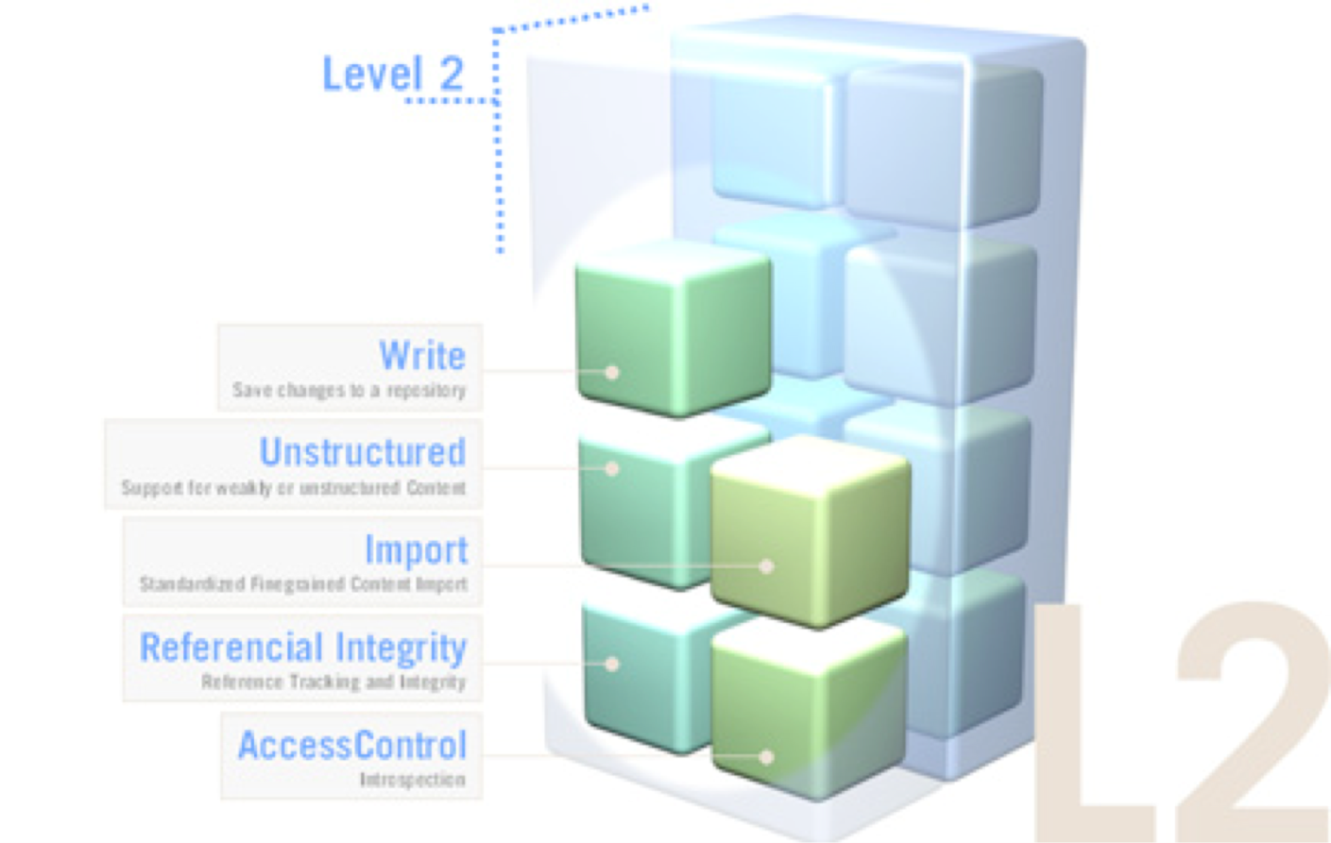
JSR 170 Overview
Level 2 includes :
Adding and removing nodes and properties
Writing the values of properties
Persistent namespace changes
Import from XML/SAX
Assigning node types to nodes

Slide 16
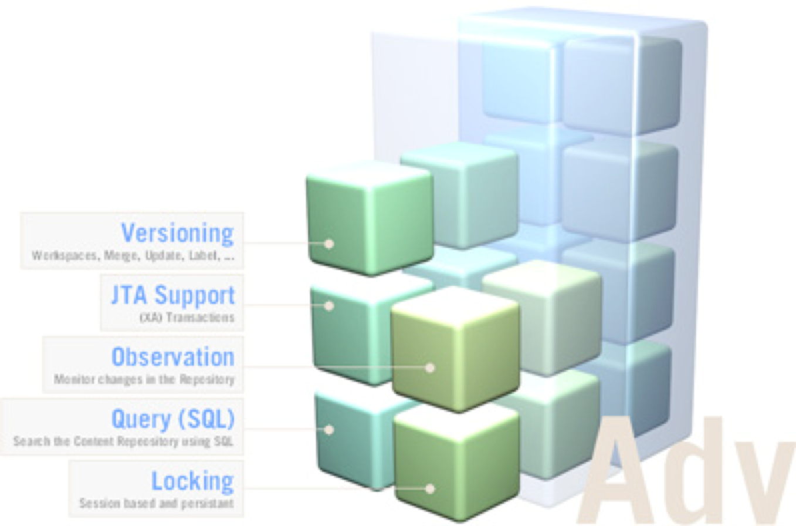

JSR 170 Overview
Optional features include :
Transactions
Versioning
Observation
Locking
SQL Search

Slide 17
JSR 170 Overview
eXo JCR additional features include :
Access Permission
XML configuration
Backup/Restore
Clustering
JMX Monitoring
Statistics
Node history Import/Export
Notes:
JCR/Workspace/Namespace/node type XML config

Slide 18
JSR 170 Overview
Create a JCR Session
// Get the Repository object
InitialContext ctx = ...
Repository repository = (Repository)ctx.lookup("myrepo");
// Get a Credentials object
Credentials credentials = new SimpleCredentials("MyName", "MyPassword".toCharArray());
// Get a Session
Session mySession = repository.login(credentials, "MyWorkspace");
Notes:
The repository as a whole is represented by a Repository object1. A client connects to the repository by calling Repository.login optionally specifying a workspace name and a Credentials object2. The client then receives a Session object tied to the specified workspace.
How the Repository object is actually acquired is beyond the scope of this specification. However, one possibility, as shown below, is to use JNDI (Java Naming Directory Interface), though this depends entirely on the implementation. Similarly, the specifics of acquiring the Credentials object are also not specified. Below we show one possibility: using the class SimpleCredentials included in the specification. Implementations may provide their own Credentials classes as well.

Slide 19
JSR 170 Overview
Traversal Access
// Get the root node
Node root = mySession.getRootNode();
// Traverse to the node you want
Node myNode = root.getNode("a/e");
// Retrieve a property of myNode
Property myProperty = myNode.getProperty("k");
// Get the value of the property
Value myValue = myProperty.getValue();
// Convert the value to the desired type
double myDouble = myValue.getDouble();
Notes:
Can call myProperty.getDouble()

Slide 20
JSR 170 Overview
Direct Access
// Directly get the property with
Property myProperty = (Property)mySession.getItem("/a/e/k");
// Directly convert to a double
double myDouble = myProperty.getDouble();
// Directly get the node thanks to its UUID
Node myNode = mySession.getNodeByUUID("1111 2222 3333 4444");
// and then get the property and convert it to a double
double myDouble = myNode.getProperty("k").getDouble();
Notes:
The node must be referenceable

Slide 21
JSR 170 Overview
Writing to the Repository
// Retrieve a node
Node myNode = (Node) mySession.getItem("/a/e");
// Add a child node
Node newNode = myNode.addNode("n");
// Add a property
newNode.setProperty("x", "Hello");
// Persist the changes
mySession.save();
Notes:
If the repository is level 2 compliant

Slide 22
JSR 170 Overview
Removing Items
// Remove the node (and its subtree)
myNode.remove();
// Persist the changes
mySession.save();
// Assume we have node /m and two properties /m/p and /m/q
Node m = (Node) mySession.getItem("/m");
Property p = m.getProperty("p");
//Remove p by calling setValue on p itself
p.setValue((Value)null);
//Remove q by calling setProperty on q's parent node
m.setProperty("q", (Value)null);
// Persist the changes
mySession.save();

Slide 23
JSR 170 Overview
Transient Storage in the Session
Sesson.save() / Item.save() -> Persists all pending changes
Session.refresh(false) / Item.refresh(false) -> Discards all pending changes
Notes:
This method is needed because changes made through most methods of Session, Node3 or Property are not immediately reflected in the persistent workspace. The changes are held in transient storage associated with the Session object until they are either persisted (using Session.save or Item.save) or discarded (using Session.refresh(false) or Item.refresh(false)).
Changes not yet saved or discarded are called pending changes. Pending changes are immediately visible through the session that made them but are not visible through other sessions accessing the same workspace.
Session.save validates and, if validation succeeds, persists all pending changes currently stored in the Session object, making them visible to other sessions (though this only applies if the save is not within the scope of a transaction, see 4.1.3.3 Transactions, below). Conversely, Session.refresh(false) discards all pending changes currently stored in the Session.

Slide 24
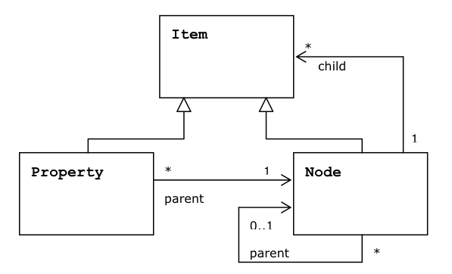
JSR 170 Overview
Nodes, Properties and Items
Notes:
This UML diagram indicates that Property and Node are subinterfaces of Item. A single Property has one and only one parent Node. A Node can have either zero parents (only if it is the root node) or one parent. A Node can have any number of child Item objects (i.e., either Property or Node objects).

Slide 25
JSR 170 Overview
Same-Name Siblings
Index Notation:
/a/b[2]/c[3]
The indexing of same-name siblings begins at 1, not 0
/a/b/c is equivalent to /a[1]/b[1]/c[1]
Properties Cannot Have Same Name Siblings
Notes:
A particular node may, in some cases, have same-name siblings, that is, other nodes that share its parent and have the same name. Whether a particular node allows this depends on the child-node definition that applies to it

Slide 26
JSR 170 Overview
Orderable Child Nodes
Orderable Same Name Siblings
Given the following initial ordering of child nodes,
[A, B, C, A, D]
a call to
orderBefore("A[2]","A[1]")
The resulting order will be:
[A, A, B, C, D]
Non-orderable Child Nodes
Properties are Never Orderable
Notes:
If the parent node supports orderable child nodes and same-name siblings then the same-name sibling child nodes will be orderable by the application just like an other child nodes. For example, given the following initial ordering of child nodes,
[A, B, C, A, D]
a call to
orderBefore("A[2]","A[1]")
will cause the child node currently called A[2] to be moved to the position before the child node currently called A[1], the resulting order will be:
[A, A, B, C, D]
where the first A is the one that was formerly after C and the second A is the one that was formerly at the head of the list.
Note, however, that after the completion of this operation the indices of the two nodes have now switched, due to their new positions relative to each other. What was formerly A[2] is now A[1] and what was formerly A[1] is now A[2].
Non-orderable Child Nodes
When a node does not support orderable child nodes this means that it is left up to the implementation to maintain the order of child nodes. Applications should not, in this case, depend on the order of child nodes returned by Node.getNodes, as it may change at any time. The only exception to this rule is that same-name siblings must maintain their relative order across read method invocations and across sessions.
Properties are Never Orderable
Properties are never client orderable, the order in which properties are returned by Node.getProperties is always maintained by the implementation and can change at any time.

Slide 27
JSR 170 Overview
Namespaces
Prefix shorthand for the full namespace
Prevent naming collisions
Built-in namespace prefixes:
jcr Reserved for items defined within built-in node types.
nt Reserved for the names of built-in primary node types.
mix Reserved for the names of built-in mixin node types.
xml Reserved for reasons of compatibility with XML.
“” (the empty prefix) This indicates the default namespace
Notes:
The name of a node or property may have a prefix, delimited by a single ':' (colon) character that indicates the namespace of the item.
Namespacing in a content repository is patterned after namespacing in XML. As in XML, the prefix is actually shorthand for the full namespace, which is a URI. URIs are used as namespaces in order to minimize naming collisions. Every compliant (level 1 or 2) repository has a namespace registry. The namespace registry always contains at least the following built-in namespace prefixes:
• jcr Reserved for items defined within built-in node types.
• nt Reserved for the names of built-in primary node types.
• mix Reserved for the names of built-in mixin node types.
• xml Reserved for reasons of compatibility with XML.
• “” (the empty prefix) This indicates the default namespace
In level 1 repositories the prefix assigned to an existing registered namespace (a URI) may be temporarily over-ridden by another prefix within the scope of a particular Session. Level 2 repositories have, additionally, the capability to add, remove and change the set of namespaces (URIs) stored in the namespace registry (excluding the built-in namespaces).

Slide 28
JSR 170 Overview
Name vs Path
A “name” in this specification is a path element without any square-bracket index.
Name and path respect the namespace mapping of the current Session.
Example:
myapp:paragraph is a name and a valid relative path
myapp:paragraph[3] is not a name, it is only a relative path.
Notes:
A “name” in this specification is a path element without any square-bracket index. For example, myapp:paragraph is a name and a valid relative path (of depth 1) whereas, myapp:paragraph[3] is not a name, it is only a relative path.
Names and paths are not simply strings with certain syntax. They have special semantics in that they respect the namespace mappings of the current Session (see 6.3 Namespaces). The special property types NAME and PATH are provided to enable the storage of these values in the repository in a namespace-sensitive way

Slide 29
JSR 170 Overview
Properties
Existing types:
String
Date (ISO 8601:2000 format: sYYYY-MM-DDThh:mm:ss.sssTZD)
Long
Double
Boolean
Name (Namespace-aware string)
Path (Absolute or Relative)
Reference (UUID + Integrity Constraint)
Binary
Multi-Value Properties (Property.getValues)
No Null Values
Notes:
In some cases, a property may have more than one value. A property that may have more than one value is referred to as a multi-valued property (regardless of whether it currently has one or more than one value).
Whether a particular property is a multi-valued property is governed by the property definition applicable to it, which is determined by the node type of the property's parent node.
The values within a multi-valued property are ordered.
Accessing the values of such a property is done with the method Property.getValues, which returns an array of Value objects that contains the values in their prescribed order.
Accessing a multi-valued property with Property.getValue, or a single-value property with Property.getValues will throw a ValueFormatException.
The values stored within a multi-valued property are all of the same type.
As with single-value properties, there is no such thing as a null value. If a value within a multi-value property is set to null, this is equivalent to removing that value from the value array. In such a case the array is automatically compacted: shifting the indexes of those values with indexes greater than that of the removed value by -1.
Note that this does mean that a multi-value property can have no values (i.e., be an empty array), whereas a single-value property either has a (non-null) value or does not exist.
No Null values
Every property must have a value. The range of property states does not include having a “null value”, or “no value”. Setting a property to “null” is equivalent to removing that property. In the case of multi-value properties, the setting of a particular value within the array to null results in the removal of that value and the compacting of the array. As a result it is possible to have a multi-value property with no values (an empty array).

Slide 30
JSR 170 Overview
Node Types
Every node must have one and only one «primary node type».
The primary node defines possible properties and possible child nodes of this node, besides of other requirements and restrictions.
The definition includes the names and types of properties and child nodes.
Each node contains a specific property called jcr:primaryType which contains the name of the primary type of the node.
Notes:
Every node must have one and only one primary node type. The primary node type defines the names, types and other characteristics of the properties and child nodes that a node is allowed (or required) to have. Every node has a special property called jcr:primaryType that records the name of its primary node type.
In addition to its primary node type, a node may also have one or more mixin types. These are node type definitions that can mandate extra characteristics (i.e., more child nodes, properties and their respective names and types) for a particular node in addition to those enforced by its primary node type. When a node is assigned a mixin node type, it acquires a special multi-value property called jcr:mixinTypes that records its mixin node types.

Slide 31

JSR 170 Overview
Node Types: Example
exo:article
Properties :
title
summary
content
Many sub-nodes files

Slide 32
JSR 170 Overview
Node Types: Inheritance
The root node type is nt:base. “nt:base” is the base type for all other types.
A primary node type always inherits from a supertype.
Inheritance includes the property and child node definitions.
A primary node type inherits also the mixin types that are assigned to the supertype.

Slide 33
JSR 170 Overview
Node Types: Mixin Type
A node can possess one or many mixin types.
A mixin type adds properties and child node possibilities and requirements to a node.
It cannot serve, by itself, to define the structure of a node. The structure is always defined by a primary type.
There is no required supertype for mixin types
A particular supported node type is either a primary type or a mixin type; it cannot be both.
When you add a mixin nodetype to a node, the node acquires a new property called jcr:mixinTypes. This multi-value property contains the names of the mixin types.

Slide 34
JSR 170 Overview
Node Types: Example #1
<nodeType name="nt:base" isMixin="false" hasOrderableChildNodes="false" primaryItemName="">
<propertyDefinitions>
<propertyDefinition name="jcr:primaryType" requiredType="Name" autoCreated="true" mandatory="true" onParentVersion="COMPUTE"
protected="true" multiple="false">
<valueConstraints />
</propertyDefinition>
<propertyDefinition name="jcr:mixinTypes" requiredType="Name" autoCreated="false" mandatory="false" onParentVersion="COMPUTE"
protected="true" multiple="true">
<valueConstraints />
</propertyDefinition>
</propertyDefinitions>
</nodeType>

Slide 35
JSR 170 Overview
Node Types: Example #2
<nodeType name="nt:unstructured" isMixin="false" hasOrderableChildNodes="true" primaryItemName="">
<supertypes>
<supertype>nt:base</supertype>
</supertypes>
<propertyDefinitions>
<propertyDefinition name="*" requiredType="undefined" autoCreated="false" mandatory="false" onParentVersion="COPY" protected="false"
multiple="true">
<valueConstraints />
</propertyDefinition>
<propertyDefinition name="*" requiredType="undefined" autoCreated="false" mandatory="false" onParentVersion="COPY" protected="false"
multiple="false">
<valueConstraints />
</propertyDefinition>
</propertyDefinitions>
<childNodeDefinitions>
<childNodeDefinition name="*" defaultPrimaryType="nt:unstructured" autoCreated="false" mandatory="false" onParentVersion="VERSION"
protected="false" sameNameSiblings="true">
<requiredPrimaryTypes>
<requiredPrimaryType>nt:base</requiredPrimaryType>
</requiredPrimaryTypes>
</childNodeDefinition>
</childNodeDefinitions>
</nodeType>

Slide 36
Overall architecture
36
Notes:
36
36

Slide 37
Overall architecture
GateIn
FTP Connector
Webdav Connector
JCA Resource Adapter
CRaSH
Chromattic
JSR 170 API
eXo JCR
Query Handler
Lock Manager
Cache
Persistence Layer
Lucene Indexes
Lock Data
Swap
Value Storage
JCR Data
Notes:
The Chromattic projects is an object mapper framework that use Java Content Repository as back end storage

Slide 38
JCR Connectors
38
Notes:
38
38

Slide 39
JCR Connectors
FTP Connector
Webdav Connector
JCA Resource Adapter
CRaSH
CMIS
RMI (jcr extension)
Notes:
Webdav Connector (with DeltaV Versioning Extensions and DASL DAV Searching and Locating, Access Control Protocol) based on JSR 311
JCA Resource Adapter (1.5) J2EE Connector Architecture
CRASH Common Reusable Shell
Content Management Interoperability Services

Slide 40
Important Links
40
Notes:
40
40

Slide 41
Important Links
GitHub
https://github.com/exodev/jcr (master)
https://github.com/exoplatform/jcr (maintenance branches)
Same logic for kernel, core and ws
Documentation
http://www.jboss.org/exojcr/documentation
Download
http://forge.ow2.org/project/showfiles.php?group_id=151
Maven Repository
https://repository.jboss.org/nexus/content/groups/public
http://repository.exoplatform.org/public

Slide 42
Exercise
42
Notes:
42
42

Slide 43
Exercise
Download the latest tomcat-jbc
Launch it
Mount a Webdav drive
http://127.0.0.1:8080/rest/jcr/repository/digital-assets/
Login: root
Pwd: exo
Add and remove Files
Add and remove Directories
Same thing with an FTP Client
Hostname: 127.0.0.1
Port: 2121
Login: root
Pwd: exo
Notes:
Compact Node Definition

Slide 44
eXo JCR version history
44
Notes:
44
44

Slide 45
eXo JCR version history
In eXo JCR 1.14
ISPN
Java Security
Apache Tika
Managed Transactions Support
Java EE Connector Architecture (JCA) Support
Asynchronous Indexing
External Backup Tools Allowed
Multi-Database Schema Support
Backup/Restore Optimized
Re-indexing improved
Shared Indexes no more required (Clustering)
Pattern-based methods improved
Parallel node startup allowed (Clustering)
Configuration variable with default value allowed
http://www.theserverside.com/discussions/thread.tss?thread_id=63038

Slide 46
eXo JCR version history
In eXo JCR 1.15
Dedicated tables per workspace
Lucene indexes re-synchronized thanks to rsync
Use System properties to configure your workspace
The extension mechanism is re-loadable
Exclude nodes from query results
CND file format support
Write operations optimizations
Smaller memory footprint
Use JCR Action as validator
Shutdown your cluster easily
http://blog.exoplatform.com/2012/12/03/whats-new-in-exo-jcr-1-15
Notes:
Compact Node Definition
Primitive Wrapper Class

Slide 47
eXo JCR
JCR concepts, architecture and benefits
Notes:
47
47

